Slide 1
Two-Way Analysis of Variance (ANOVA)
Understanding the Impact of Two Independent Variables on a Dependent Variable

Slide 2
Introduction
Two-Way ANOVA assesses the joint impact of two independent variables on a dependent variable.
Importance: Crucial for understanding complex interactions in research and analysis.
Applied in psychology, medicine, marketing for a nuanced understanding.
Provides a comprehensive analysis in a single test, saving time.
Example: Study on diet and exercise impact, revealing combined effects.

Slide 3
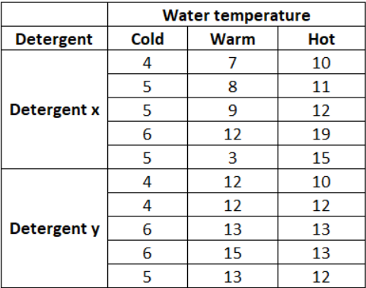
Experimental Design
Factors:
Detergent Type (Factor 1):
Detergent X
Detergent Y
Water Temperature (Factor 2):
Cold
Warm
Hot
Data:
Crops were washed with two detergents (X and Y) at different water temperatures.
Crop cleanliness was measured on a scale from 1 to 20.
Scenario: Studying the Impact on Crop Cleanliness

Slide 4
Hypotheses
Null Hypotheses (H₀):
H0​: There is no significant difference in crop cleanliness based on detergent type.
H0​: There is no significant difference in crop cleanliness based on water temperature.
H0​: There is no interaction effect between detergent type and water temperature on crop cleanliness.
Alternative Hypotheses (H₁):
H1​: There is a significant difference in crop cleanliness based on detergent type.
H1​: There is a significant difference in crop cleanliness based on water temperature.
H1​: There is an interaction effect between detergent type and water temperature on crop cleanliness.
Notes:
Factor: A variable that can be manipulated in an experiment (e.g., Detergent Type or Water Temperature).
Level: The specific values or categories within each factor (e.g., Detergent X and Detergent Y for Detergent Type).

Slide 5
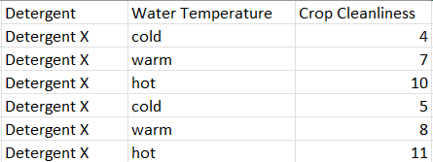
Data Organization
Data Organization for Two-Way ANOVA:
Factor 1: Detergent Type
Levels: Detergent X, Detergent Y
Factor 2: Water Temperature
Levels: Cold, Warm, Hot

Slide 6
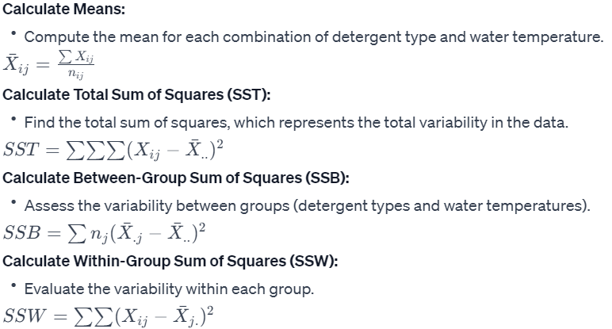
Calculations

Slide 7
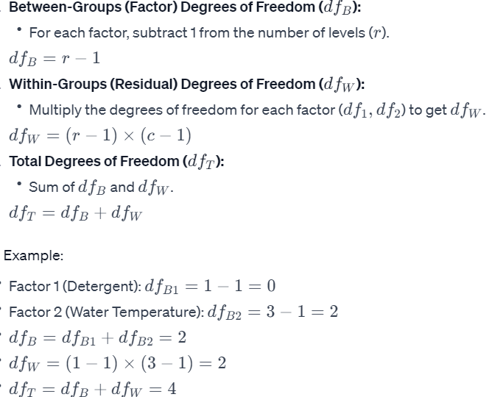
Degrees of Freedom

Slide 8
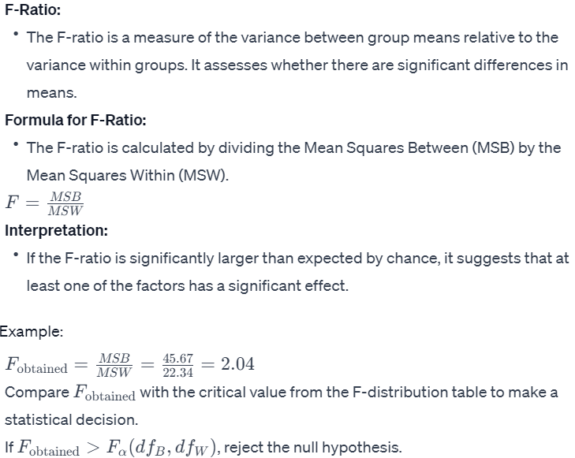
F-Ratio

